Slide 1





Evaluation of Movies Data.
What are factors affect this?
Group- 9
David Kramer, Mojtaba Zadaskar, Yalda Alemi and Deepika Mehanti

Slide 3
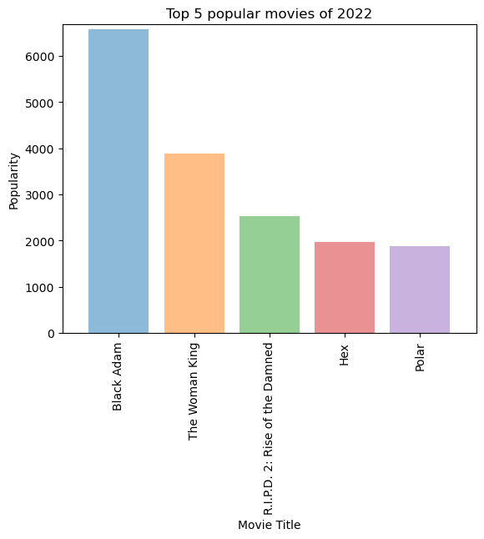
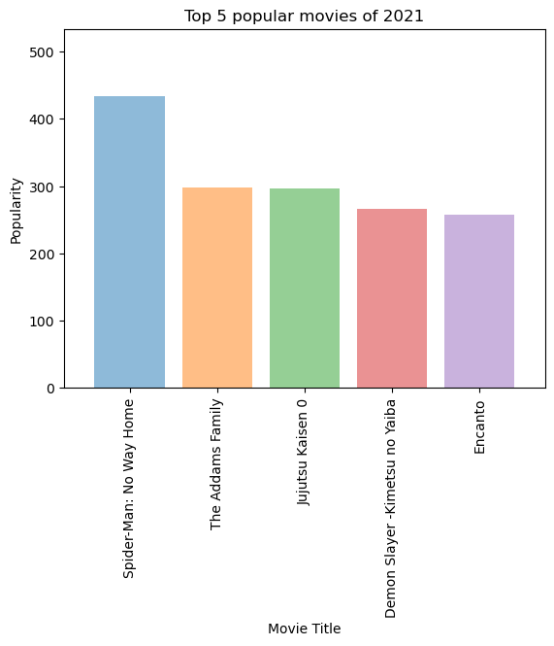
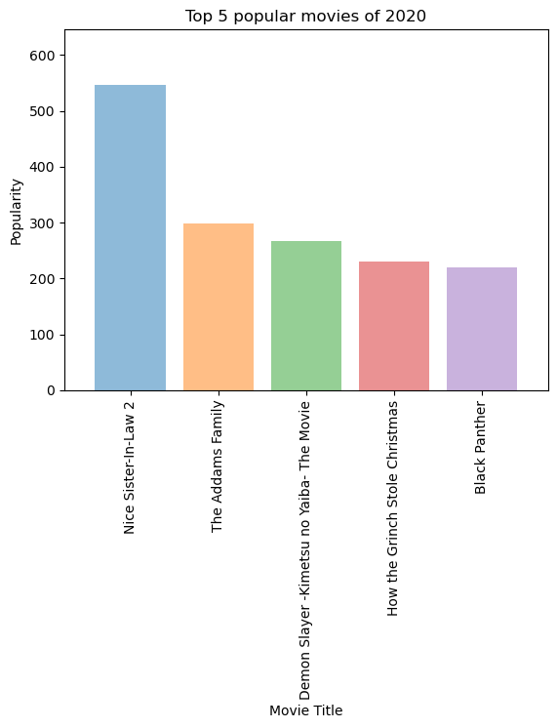
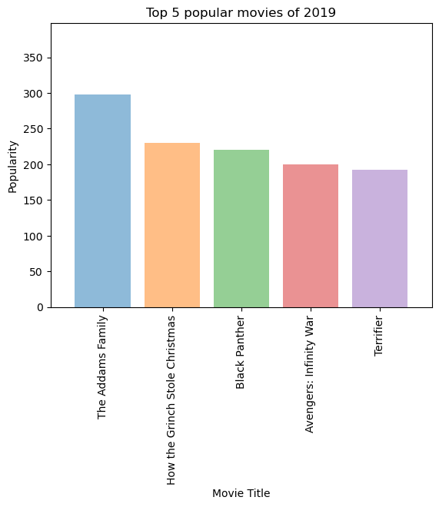
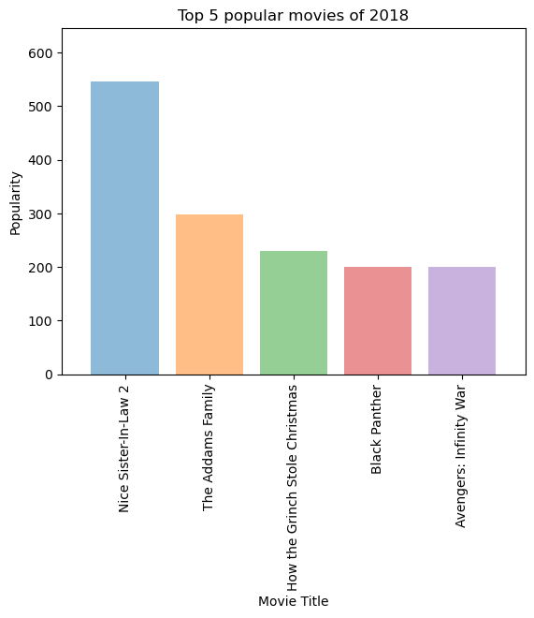
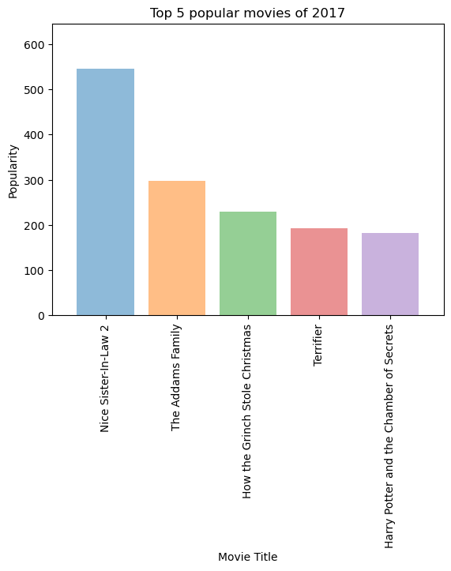
Top 5 Poplar Movies
2017-2022
Movies which are consistently in Top 5 .
The Adams family 2017-2021.
How the Grinch stole Christmas 2017-2020.
Black Panther 2018-2020
Black Adam is leading in year 2022.

Slide 4
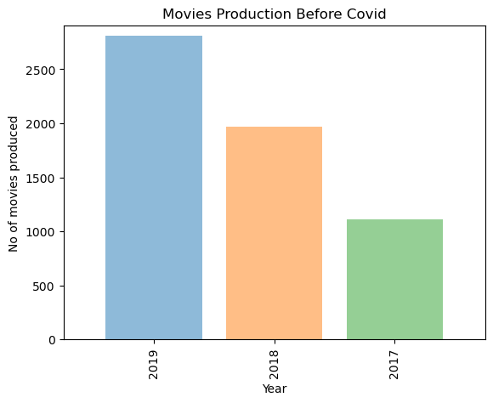
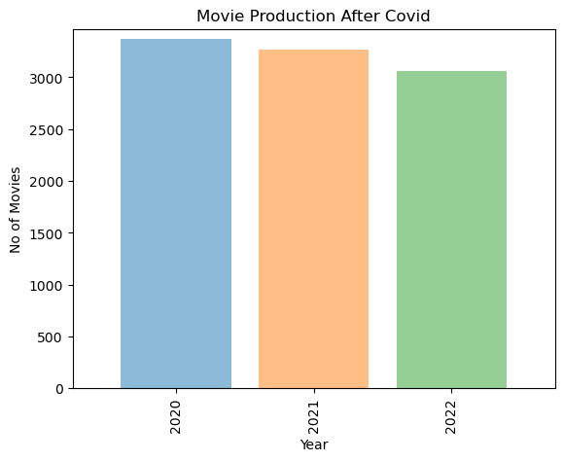
Movie Produced Before and After Covid-19
Movies Produced Before Covid -19
From Year 2020-2022
Movies Produced After Covid -19
From Year 2020-2022

Slide 5
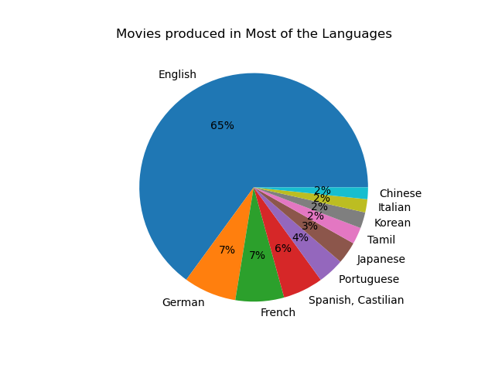

Movies Produced in Most Languages.
English
German
French
Spanish
Portuguese
Tamil
Korean
Italian
Chinese

